Slide 1


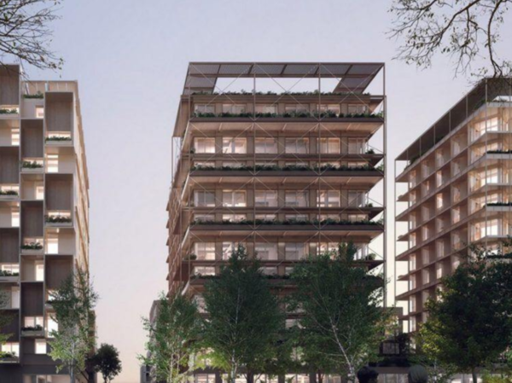
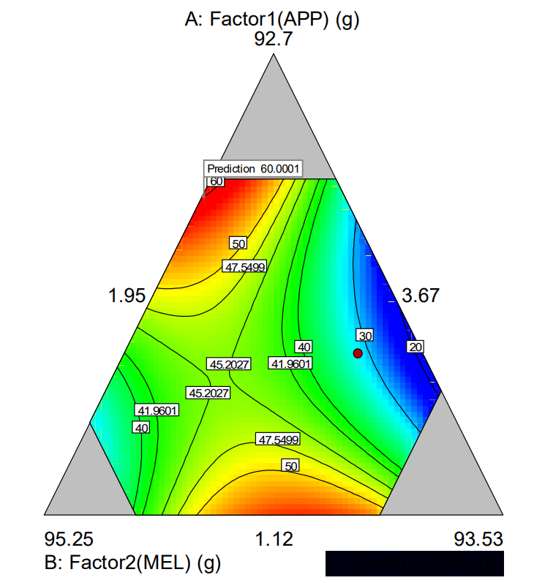
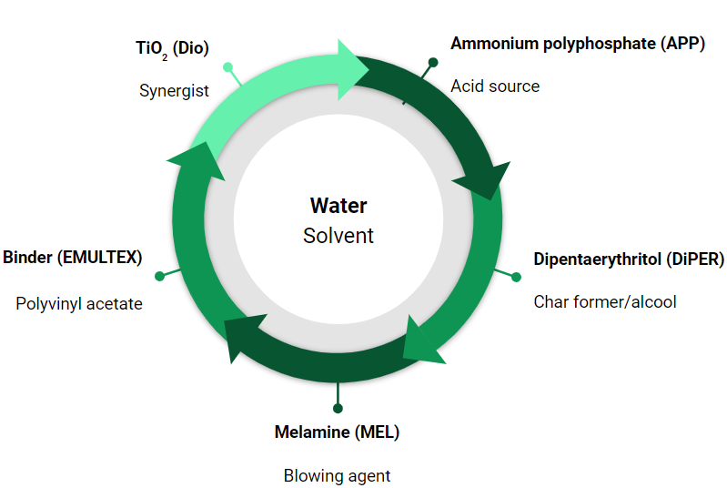
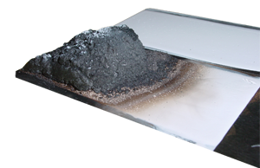


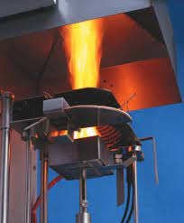
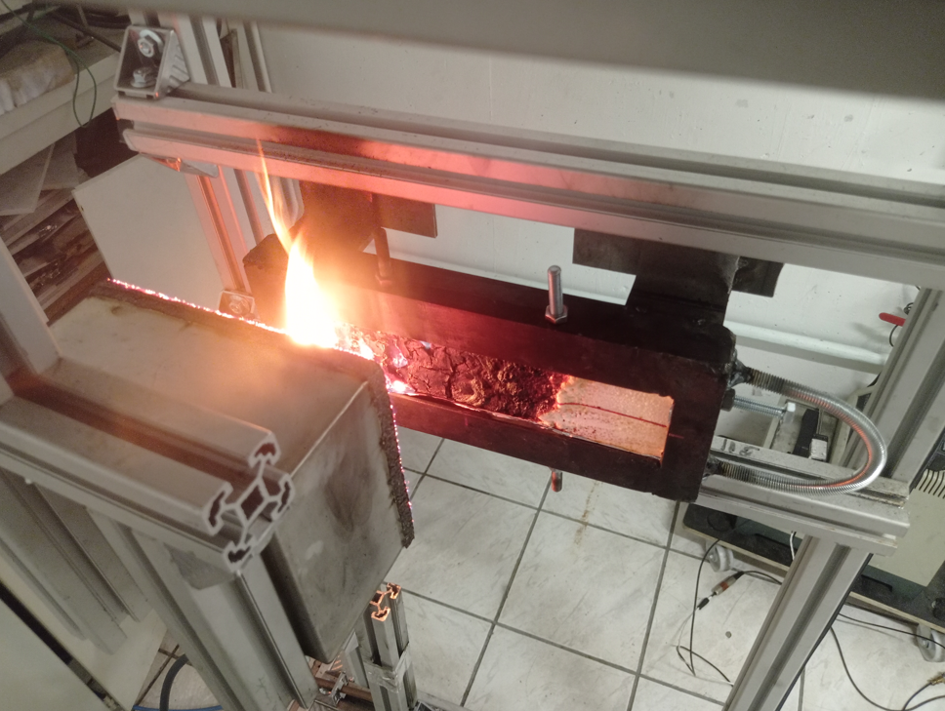
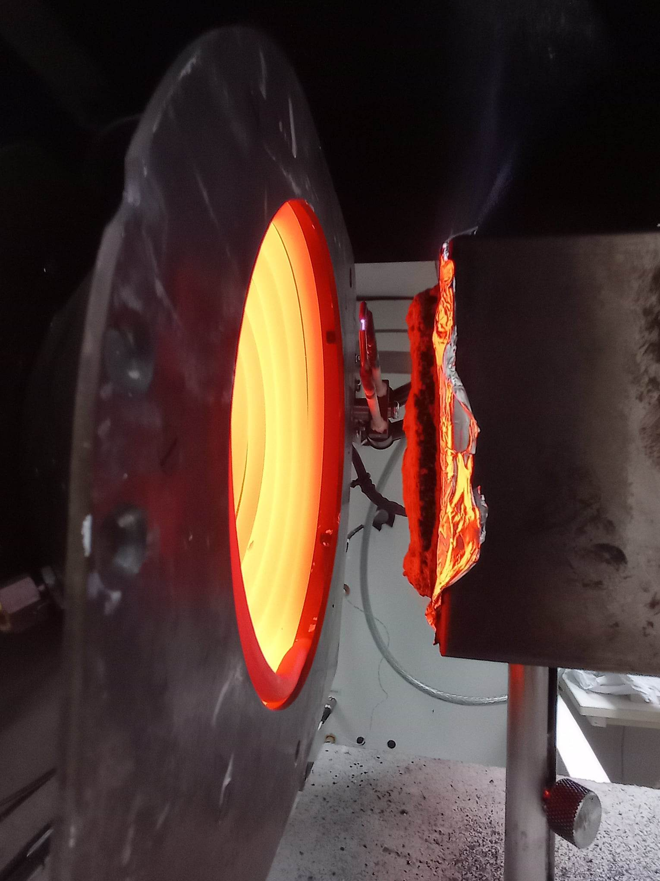
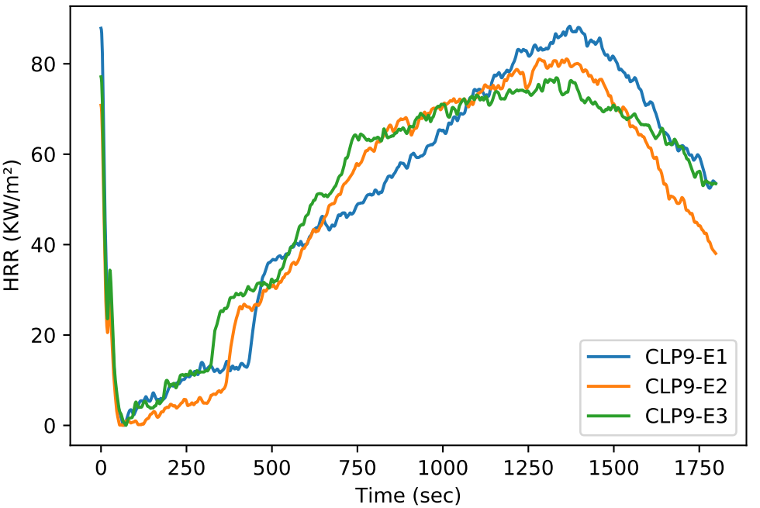
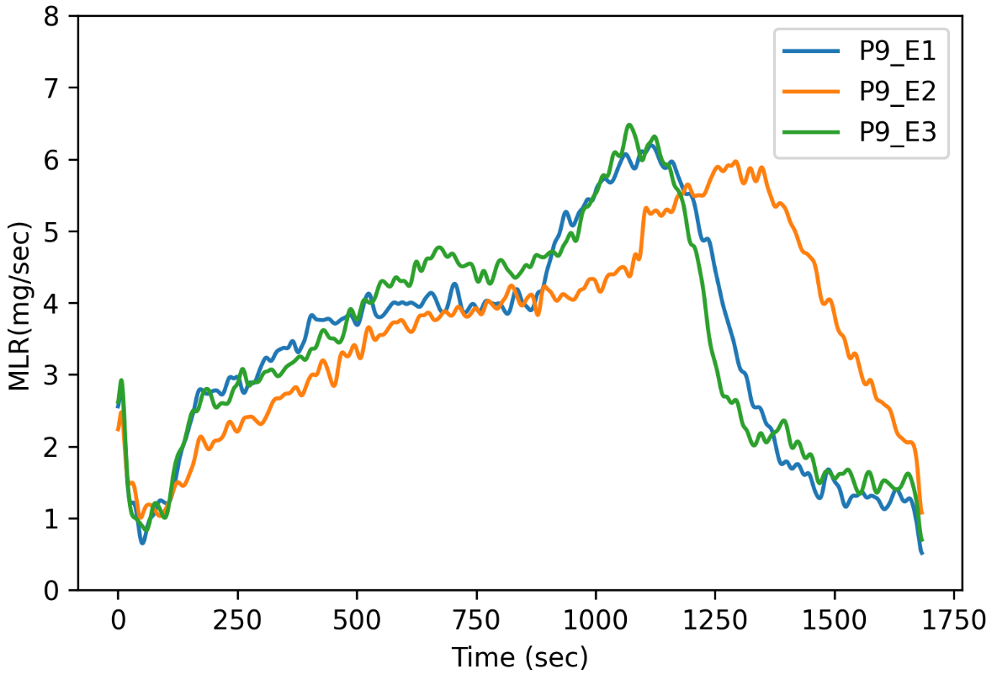
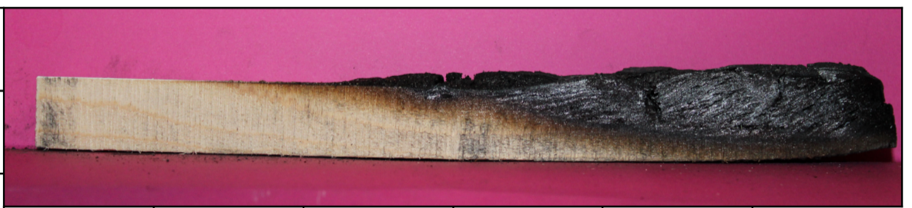
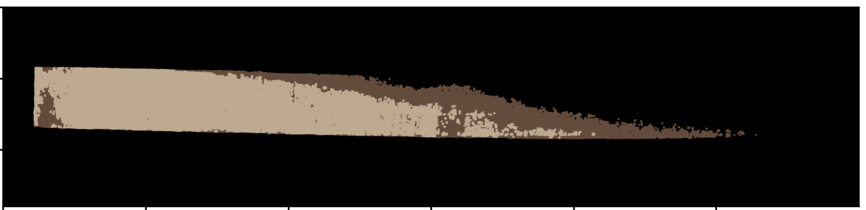
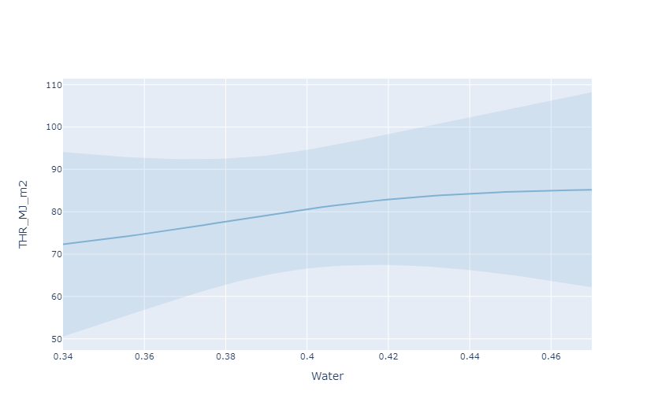
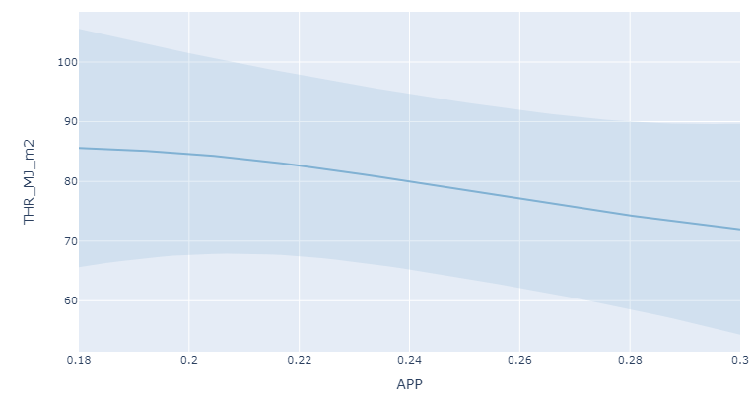
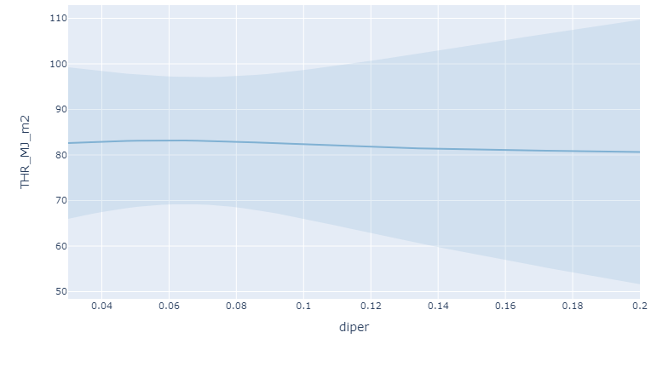
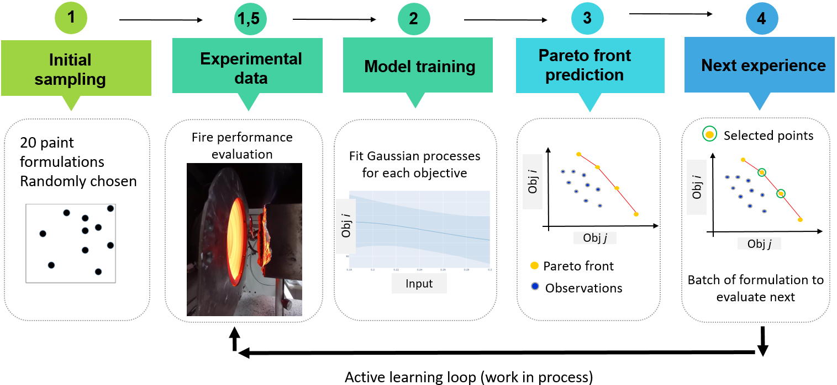
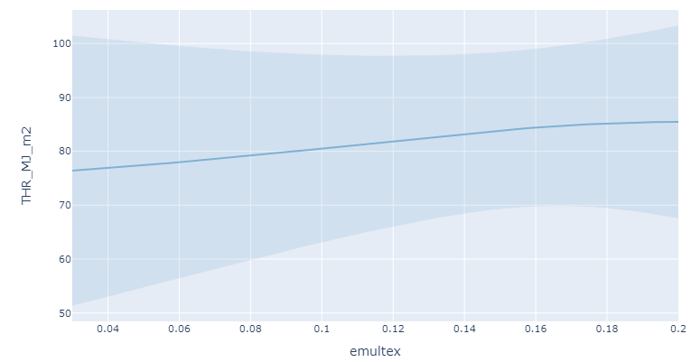
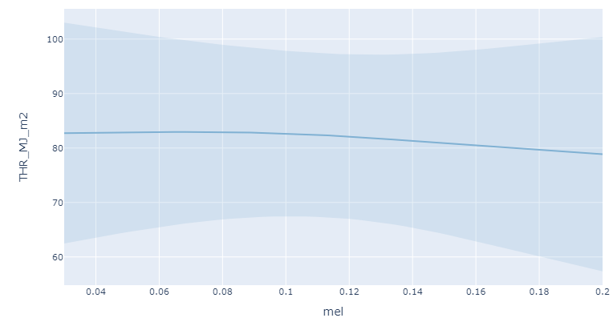
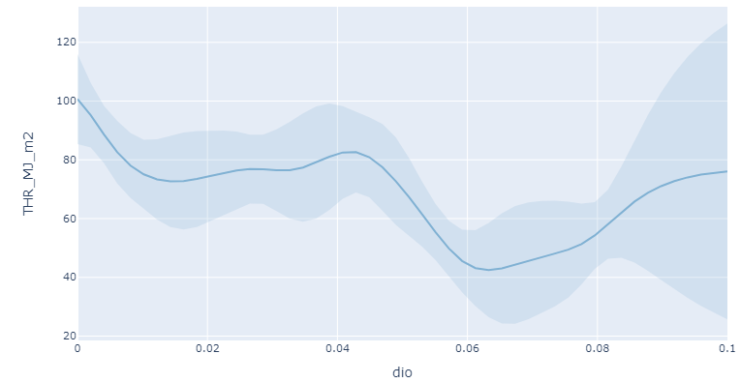
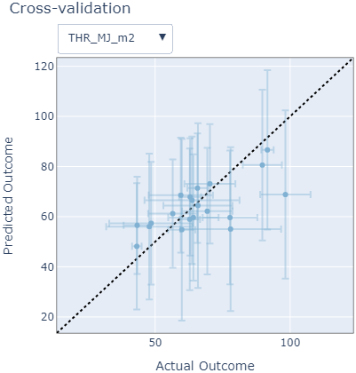
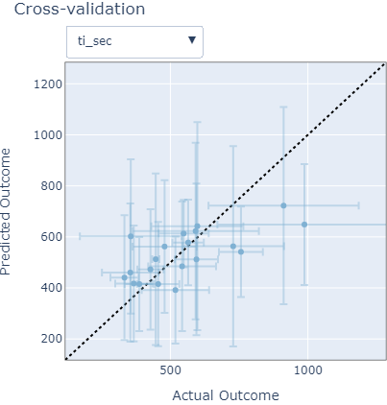
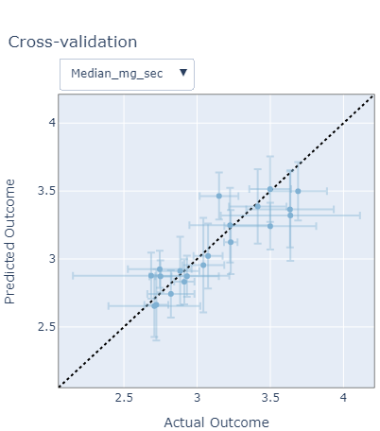
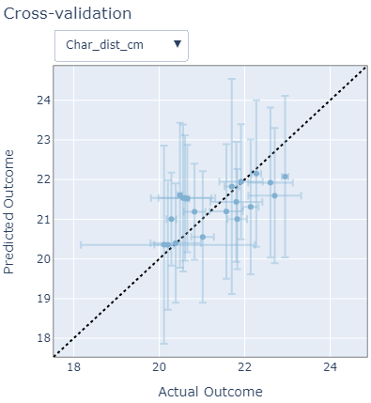


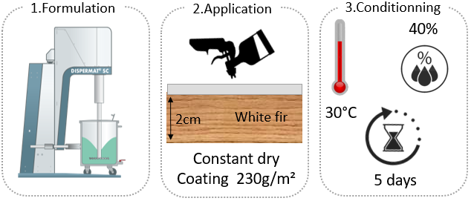


Multi-objective Bayesian optimization for intumescent coating
Eric VERRET, Prof Sophie DUQUESNE, Prof Anthony COLLIN
Univ. Lille, CNRS, INRAE, Centrale Lille, UMR 8207 - UMET - Unité Matériaux et Transformations, F-59000 Lille, France/Université de Lorraine
Aims/objectives
Input
Intumescent coating most commune system to protect wood against fire in structures
$$=1$$
Wood is more and more used in buildings = sustainable materials compared to concrete and steel
Intumescent coatings react => an expanded structure limiting heat and mass transfer
Design of Experiement (DoE):
$$\sum_{i=1}^{6}{x_{i}}=1$$
Input: weight pourcentage
High dimension
Multi-objective
Noisy observation
Output
3 Fire tests → 4 performance outcome
Vertical mass loss cone
Horizontal mass loss cone
CFE 1/3 scale
Vertical → more representative of fire in a building and impact gravity on the intumescent char
The flame propagation is evaluated using a lab-made by small scale
CFE radiant panel test (similar to the ISO5658-2)
3 - distance of degradation
1 - Total heat released (THR)
2 - Time of ignition (ti)
4 – Median of the mass loss rate
Heat flux: 50 KW/m²
Test time: 30 min
Heat flux: 50 KW/m²
Test time: 30 min
Determination of distance of degradation via image segmentation (K-means clustering )
Pipeline
Prediction
Gaussian process fit
Mean of the prediction
Bayesian optimization (BO) is a sequential model-based approach that efficiently explores and exploits the search space to find the optimal solution of a black-box function with limited evaluations. BO can be used for noisy and small dataset.
95% confidence
Gaussian prior
Metric evaluation
In Multi-objective optimisation there is typically no single best solution. The Pareto front is the set of solutions where no other solution can improve one objective without sacrificing another. It represents the optimal trade-off between conflicting objectives, providing a range of solutions, to guide decision-making.
Experimental protocol
Metric | THR | Ti | Median of MLR | Distance of degradation
Mean absolute percentage error (MAPE) | 13% | 17% | 3% | 2%
Coefficient of correlation | 0,67 | 0,73 | 0,89 | 0,67
Fisher exact test p value | 0,011 | 0,011 | 0,0005 | 0,32
Error bar: 95% confidence
Model evaluation technique: Leave one out cross-Validation (LOOCV)
The coating formulations were obtained a dispersion using a high-speed disperser
A constant dry mass is applied on white fir
The sample is conditioned at 30°C, 40% RH during before the fire testing
Conclusion/perspective
References
Intumescent is an efficient method to protect wood against fire in a building
Designs of experiment are very efficient but require high amount of data
The performance of the coating is evaluate by 3 fire tests giving 4 parameters of performance
Multi-objective Bayesian Optimisation has been chosen to find the optimum configuration of the paint (pareto front) and minimize the number of samples
Outlooks
Number evaluation until a satisfactory approximation of the Pareto front is obtained
Comparison between different sampling for initial points
Tonooka, Y., Takaguchi, H., Yasui, K., & Maeda, T. (2014). Life cycle assessment of a domestic natural materials wood house. Energy Procedia, 61, 1634-1637.
Puri, R. G., & Khanna, A. S. (2017). Intumescent coatings: A review on recent progress. Journal of Coatings Technology and Research, 14(1), 1-20.
Weil, E. D. (2011). Fire-protective and flame-retardant coatings-A state-of-the-art review. Journal of fire sciences, 29(3), 259-296.
Naik, D., & Shah, P. (2014). A review on image segmentation clustering algorithms. Int J Comput Sci Inform Technol, 5(3), 3289-93.
Shields, B. J., Stevens, J., Li, J., Parasram, M., Damani, F., Alvarado, J. I. M., ... & Doyle, A. G. (2021). Bayesian reaction optimization as a tool for chemical synthesis. Nature, 590(7844), 89-96.
Wang, Y., Chen, T. Y., & Vlachos, D. G. (2021). NEXTorch: A Design and Bayesian Optimization Toolkit for Chemical Sciences and Engineering. Journal of Chemical Information and Modeling, 61(11), 5312-5319.

